Slide 1
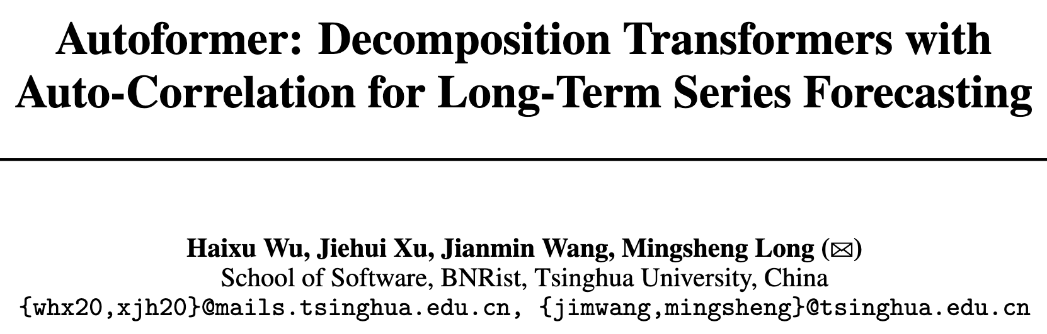

Slide 2
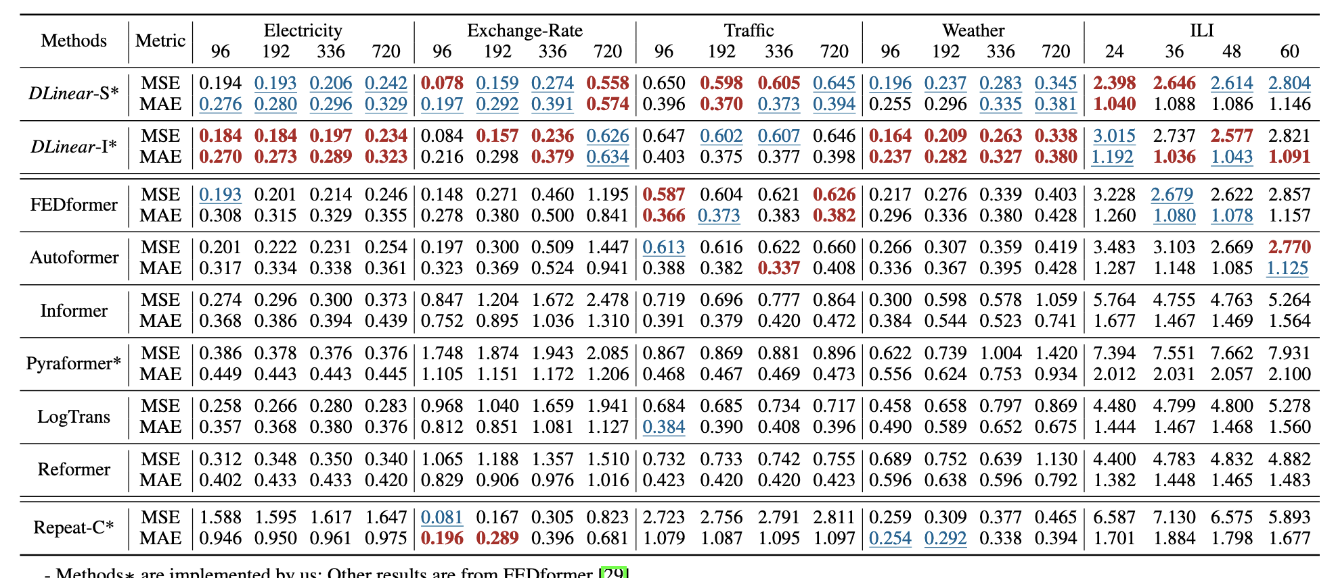
Dlinear: Are Transformers Effective for Time Series Forecasting?
Zeng A, Chen M, Zhang L, et al. Are Transformers Effective for Time Series Forecasting?[J]. arXiv preprint arXiv:2205.13504, 2022.

Slide 3
随机过程理论 stochastic process theory
一族无穷多个、相互有关的随机变量，就是随机过程。例如马尔可夫过程属于随机过程。
马尔可夫过程：
马尔可夫性=无后效性

Slide 4
Decomposition of Time Series
“To handling intricate temporal patterns and breaking the bottleneck of computation efficiency and information utilization.”
rend-seasonality decomposition from Prophet²
matrix decomposition from DeepGLO³
2. Sean J Taylor and Benjamin Letham. Forecasting at scale. Am. Stat., 2018
3. Rajat Sen, Hsiang-Fu Yu, and Inderjit S. Dhillon. Think globally, act locally: A deep neural network approach to high-dimensional time series forecasting. In NeurIPS, 2019.

Slide 5
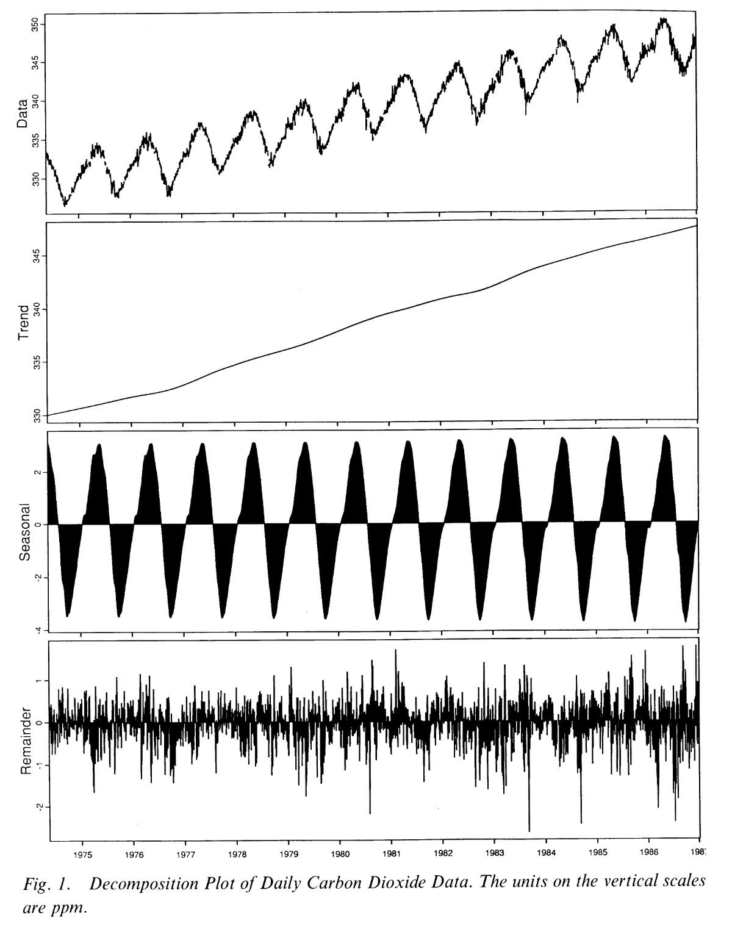
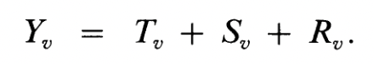
seasonal-trend decomposition(STL)
Cleveland Robert, C William, and Terpenning Irma. STL: A seasonal-trend decomposition procedure based on loess. J. Off. Stat, 1990.

Slide 6
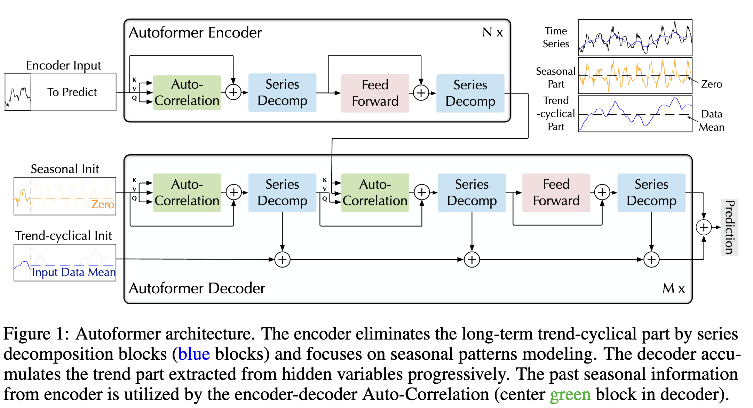
Framework

Slide 7
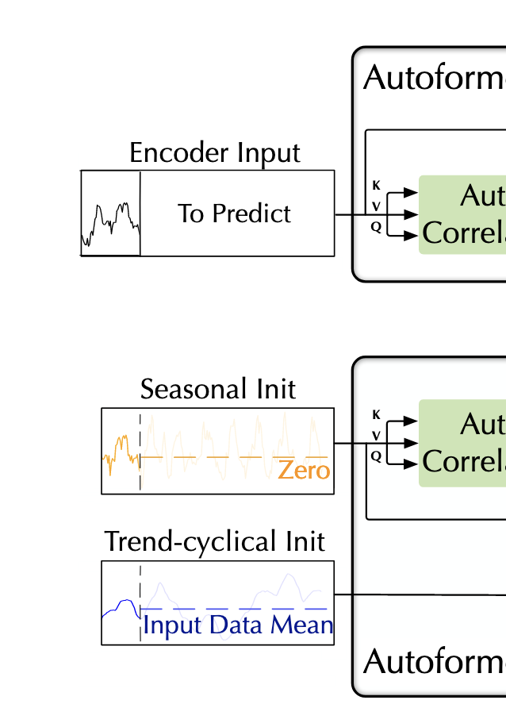
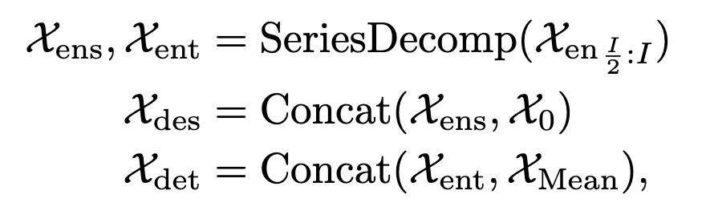
Model inputs

Slide 8
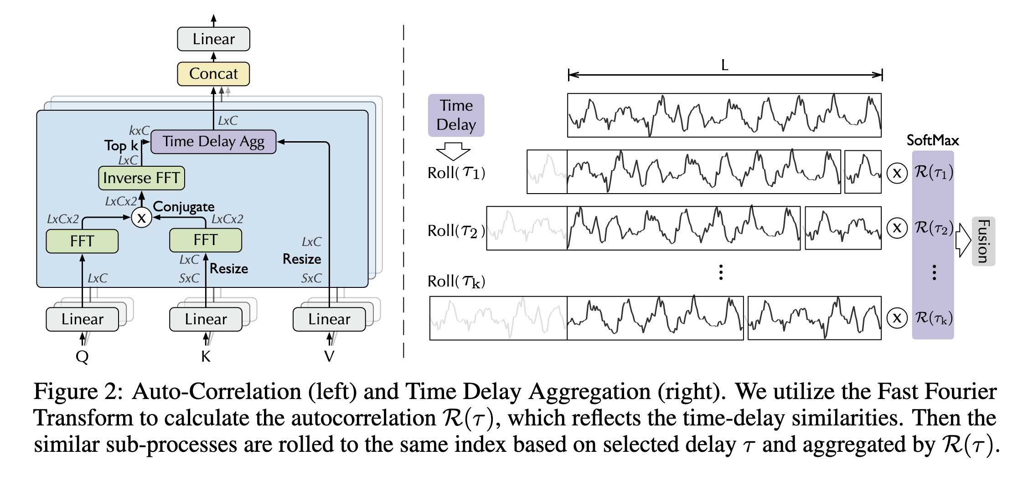
Auto-Correlation

Slide 9
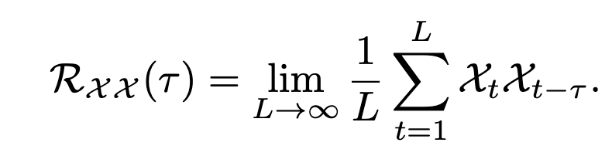
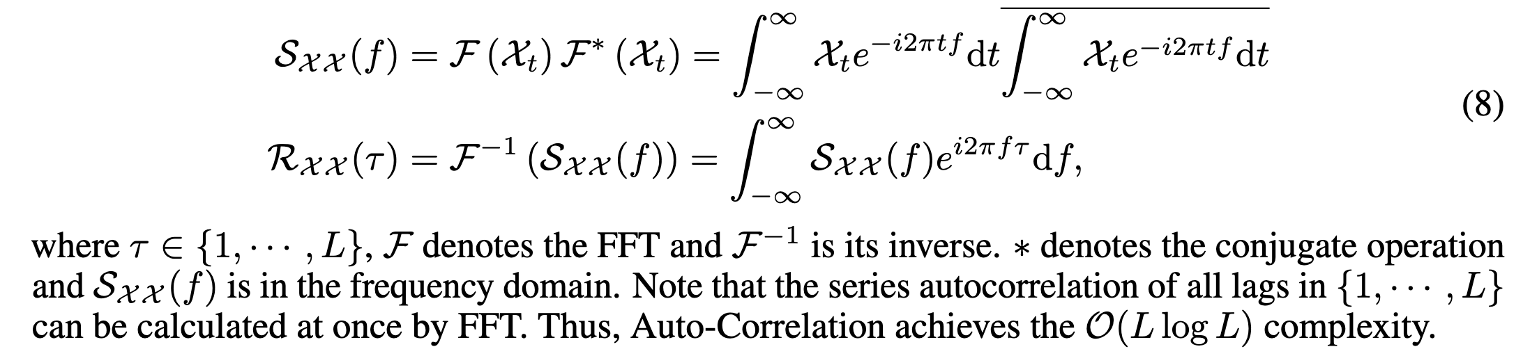
Auto-Correlation
Period-based dependencies
Efficient computation

Slide 10
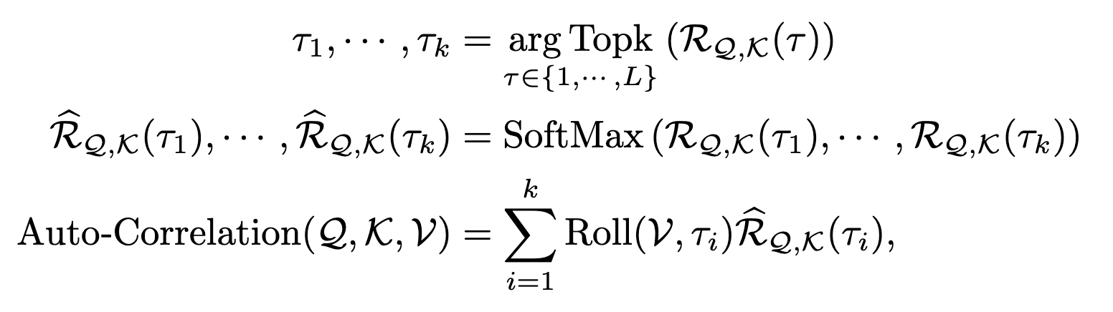
Auto-Correlation
Time delay aggregation

Slide 11
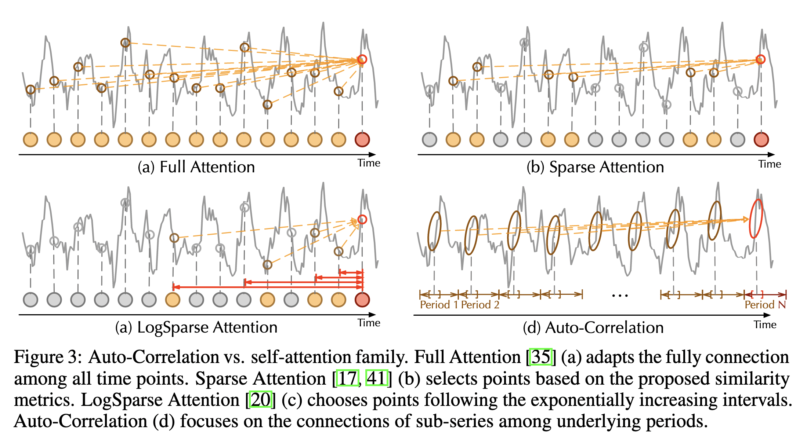
Auto-Correlation

Slide 12
Framework

Slide 13
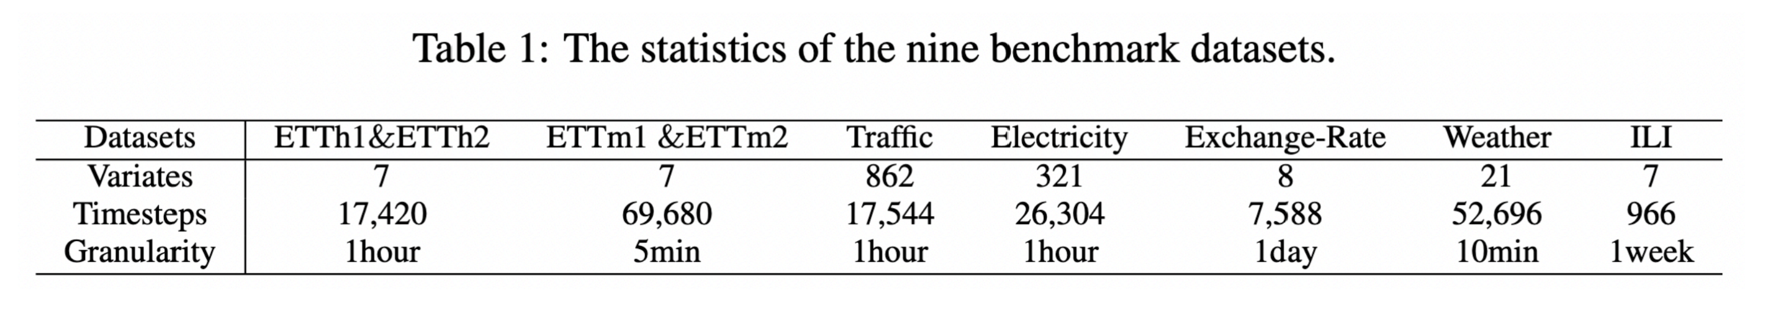
Datasets
Zeng A, Chen M, Zhang L, et al. Are Transformers Effective for Time Series Forecasting?[J]. arXiv preprint arXiv:2205.13504, 2022.

Slide 14
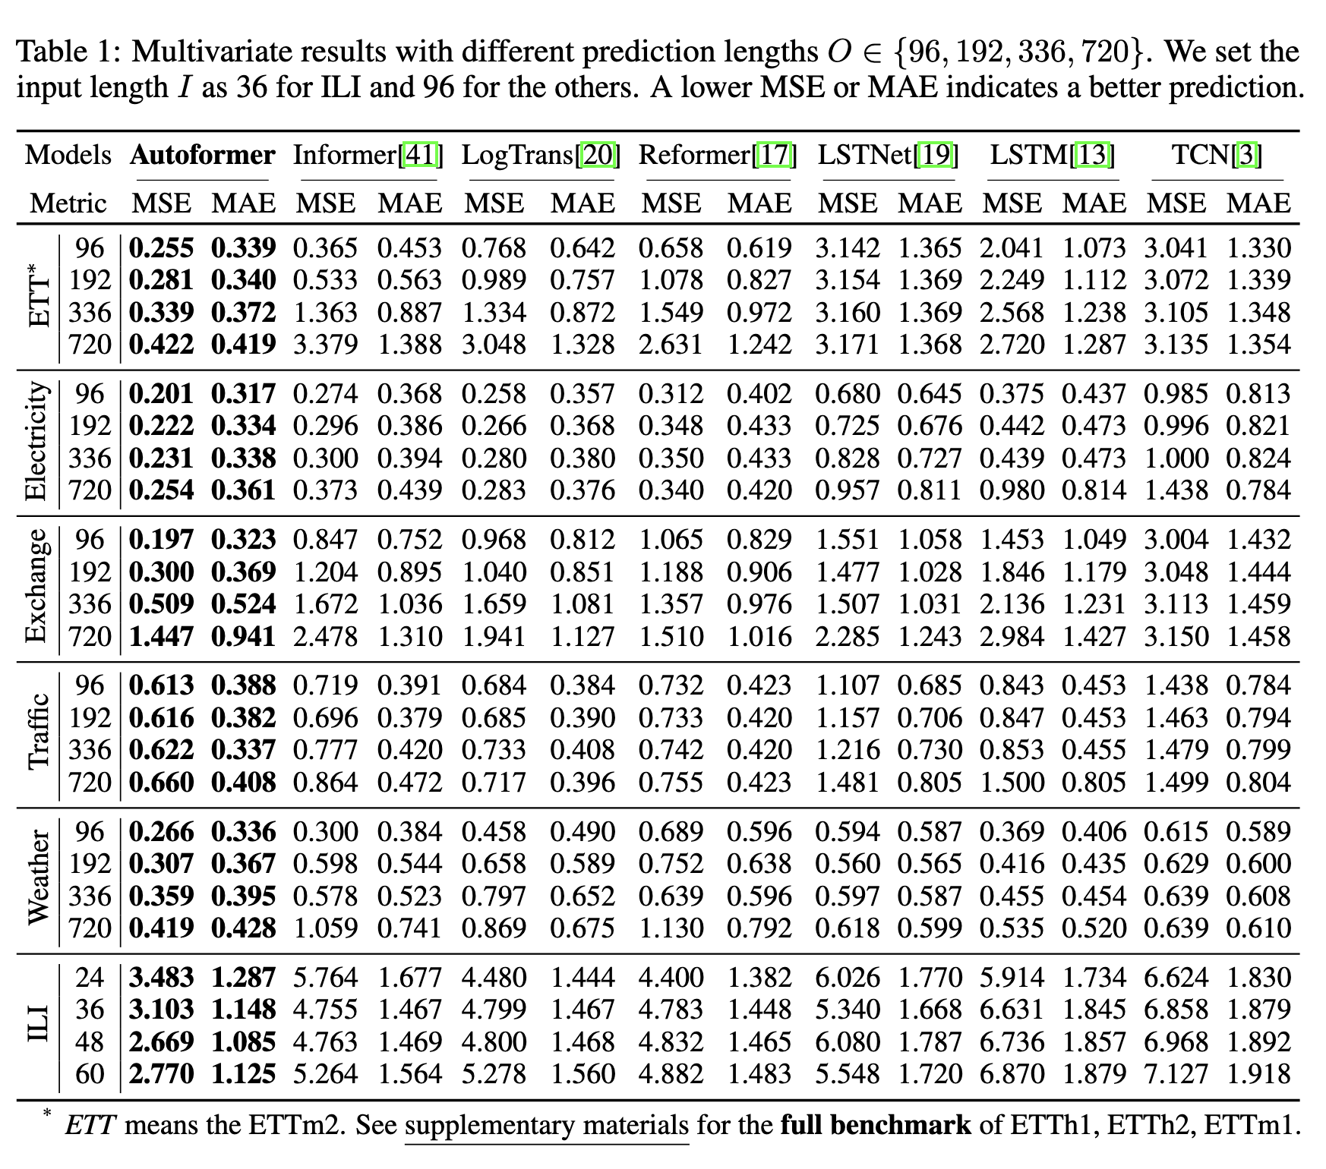
Experiments

Slide 15
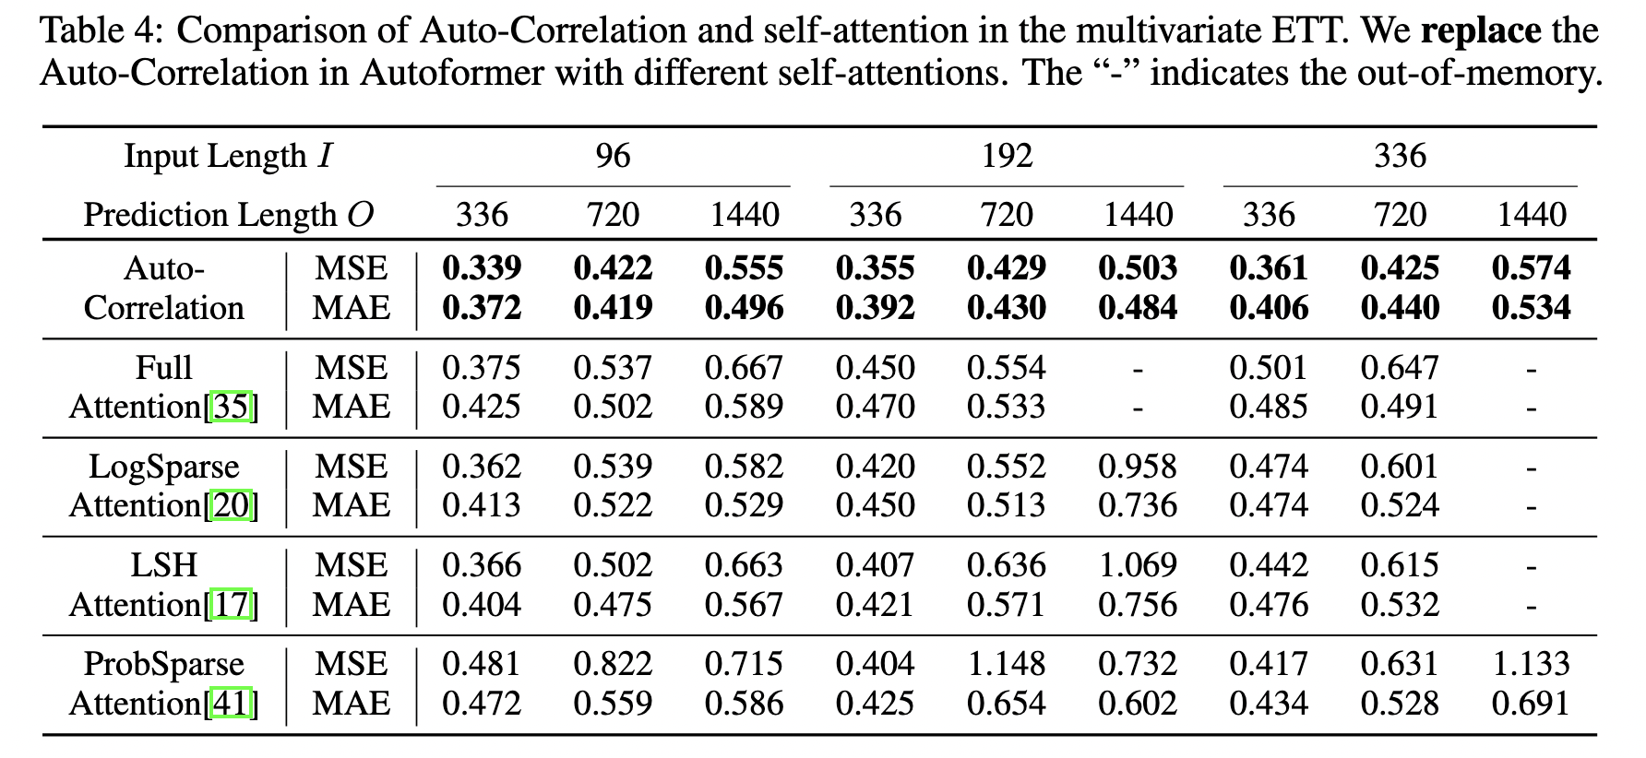
Ablation studies
Auto-Correlation vs. self-attention family

Slide 16
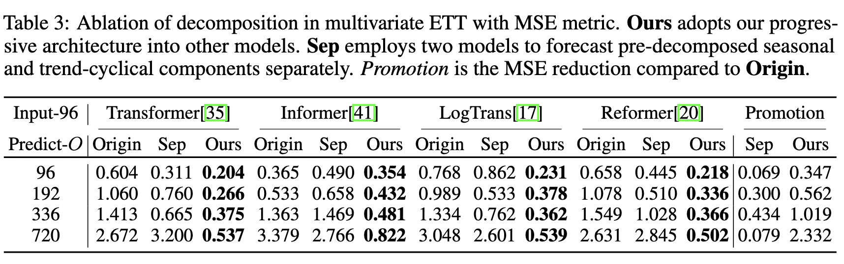
Ablation studies
Decomposition architecture

Slide 17
Thank you

